Slide 1
Retrospective on being an Agile Coach
Scott Bird, Lead Agile Coach
October, 2015

Slide 2
My Journey

Slide 3
Agile Implementation: Top Down vs Bottom Up
Consistent implementation
Better coordination across enterprise
Coaches!
Expensive
Standardization vs Agility
“Sticks” better at the team level
Lower “burn rate”
Inconsistent methodologies

Slide 4
Anchors and Engines
Visual Tools
Train teams, not individuals!
Retros need an action plan!
Maintain Your Balance
Stay Engaged!
Change up the Retros!
Burndowns are critical!
Be present!
Don’t Spread Yourself Too Thin
Agile Tool Training
Metrics!
Enterprise Support
Executive Buy In
Product Owner
Roll Up Impediments
Teams Too Big!

Slide 5
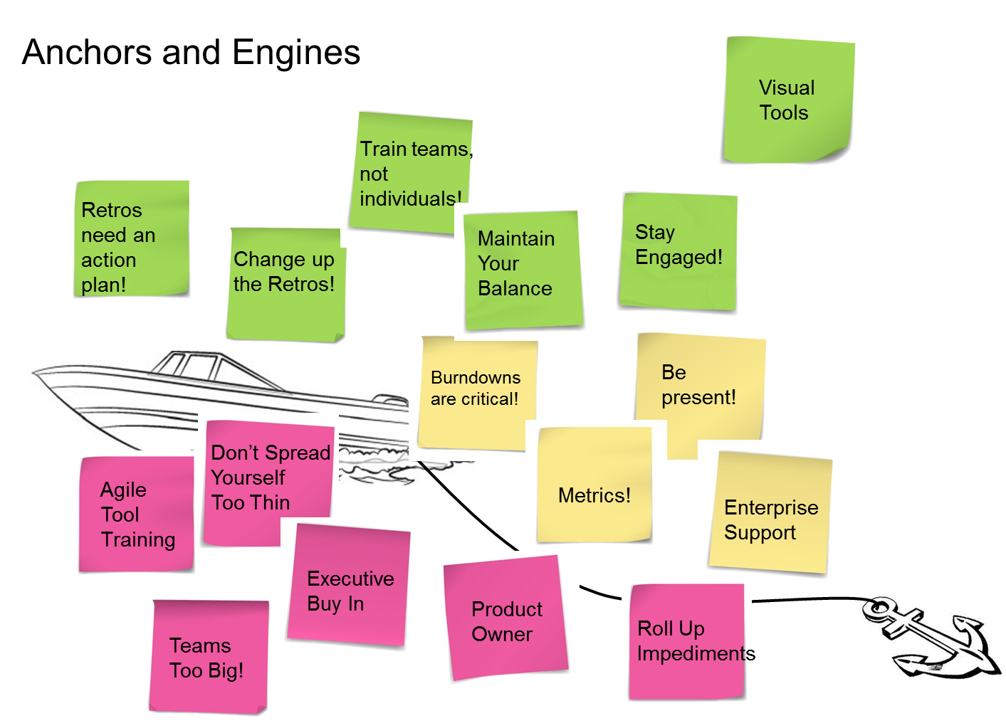
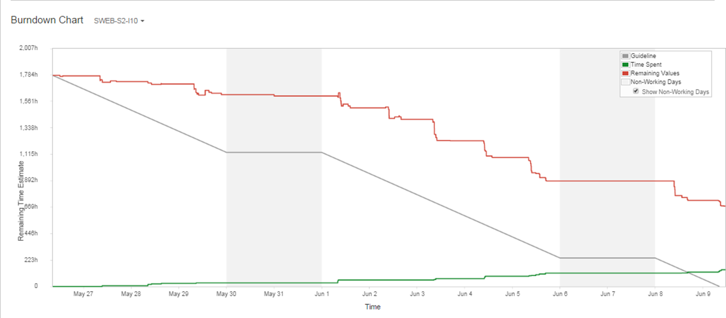
Burndowns are Critical!

Slide 6
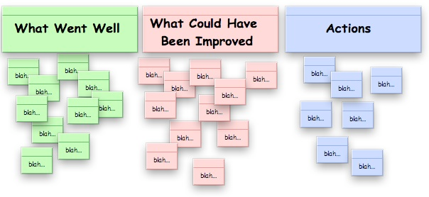
Retrospectives need an Action Plan!
?

Slide 7
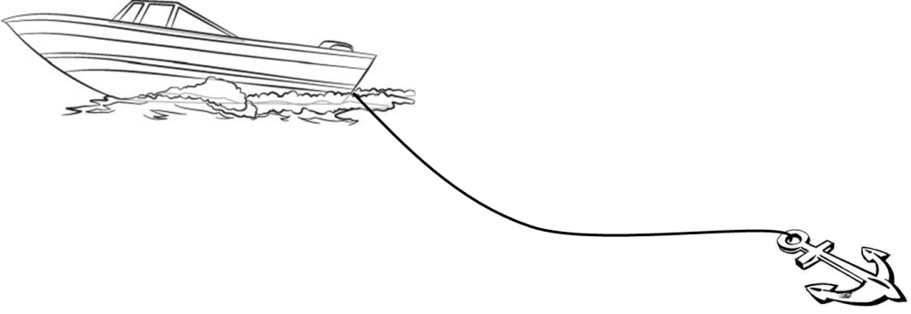
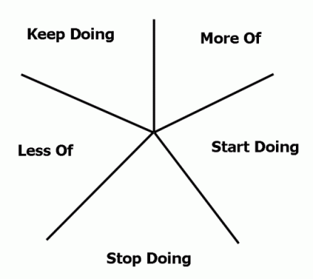
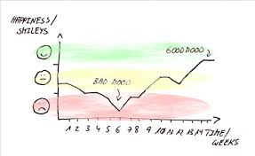
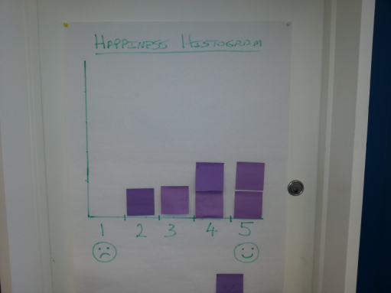
Change Up the Retrospectives!

Slide 8
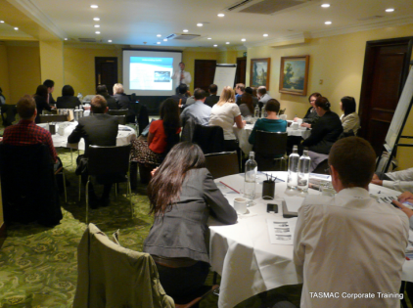
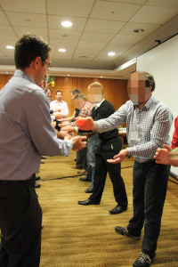
Train teams, not individuals!
Notes:
Have the entire team take training together
Have all the roles in training together
Make it interactive

Slide 9
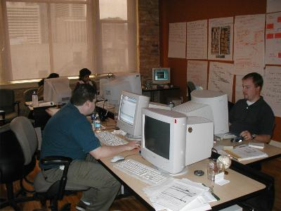
Be present!
Notes:
Release planning
Iteration planning
Showcases
Retrospectives – telepresence!

Slide 10
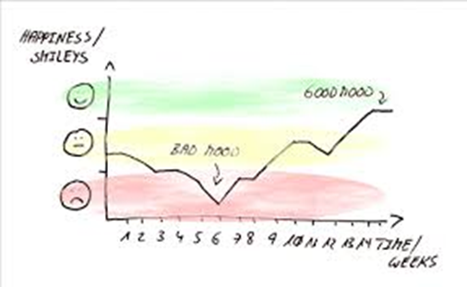
Metrics: Are we getting better?
Metrics: Are we getting better?
Notes:
Velocity over time
Sprint actuals vs. commitment
Release Planning
Waste
Happy-ness

Slide 11
Maintain your balance!
Discover
Direct
Notes:
Focus on team success vs enterprise success
Has responsibility for outcomes vs Not directly responsible for outcome
“It’s their meeting”
Protects the team vs Advises, but does not protect the team

Slide 12
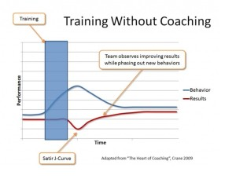
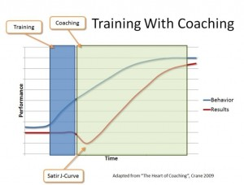
Stay
engaged!
Notes:
Training Coaching
Finite duration Ongoing
Knowledge / Skill based Skill and Competency based
Classroom setting “On the job”
Generalized for all attendees Specific to individual / team
The “Shu” of Shu-Ha-Ri The “Ha” of Shu-Ha-Ri

Slide 13
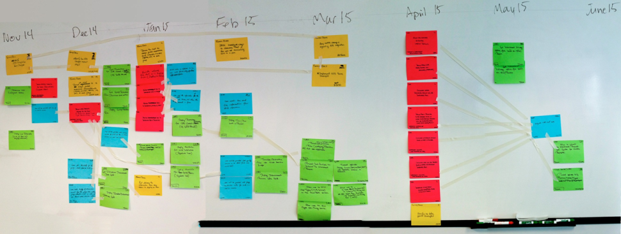
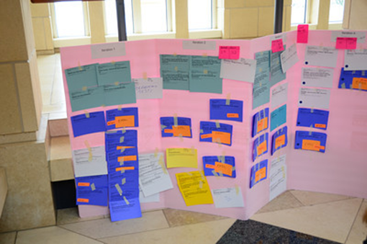
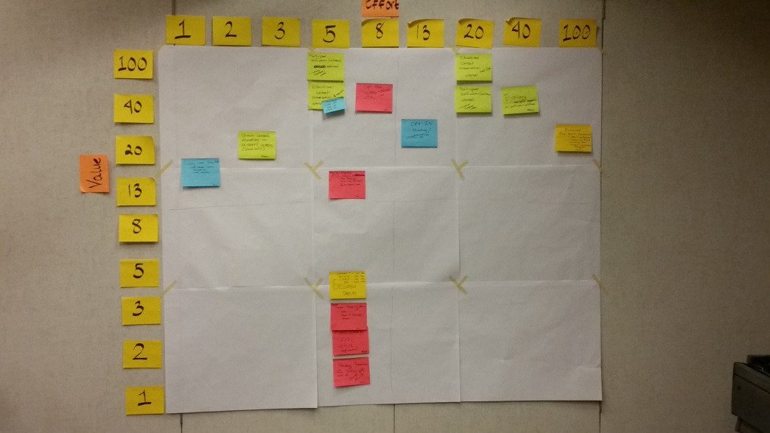
Use visual tools!

Slide 14
Enterprise support
Dev
PM
BA
QA
MW

Slide 15
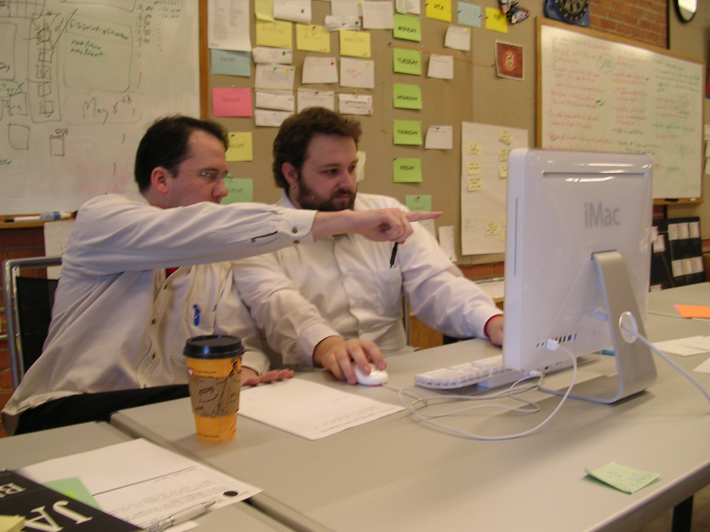
Don’t forget tool training!

Slide 16
Don’t spread yourself too thin!
Notes:
1-2 teams vs 2-5 teams
Protects the team vs Advises, but does not protect the team

Slide 17
Executive buy in

Slide 18
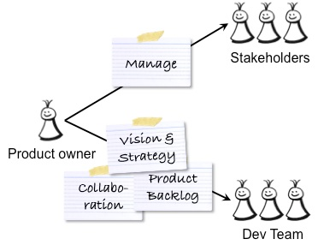

Slide 19
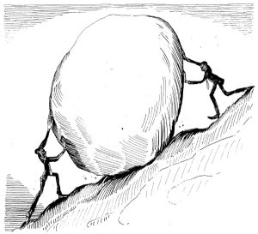
Roll up impediments!

Slide 20
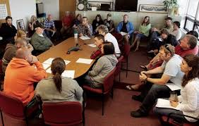
Teams too big!

Slide 21
And in conclusion
Agile is a journey
Agile coaching is a journey
Any questions?

Slide 22
Scrum Master vs Agile Coach
Scrum Master | Agile Coach
1-2 teams | 2-5 teams
Focus on team success | Focus on enterprise success
Has responsibility for outcomes | Not directly responsible for outcome “It’s their meeting”
Protects the team | Advises, but does not protect the team

Slide 23
Training vs Coaching
Training | Coaching
Finite duration | Ongoing
Knowledge / Skill based | Skill and Competency based
Classroom setting | “On the job”
Generalized for all attendees | Specific to individual / team
The “Shu” of Shu-Ha_Ri | The “Ha” of Shu-Ha-Ri

